Slide 1

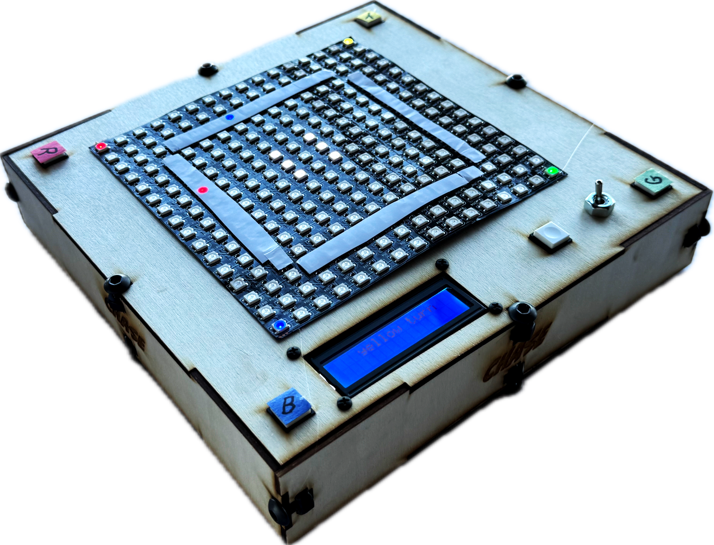
Ella Conley
Eve Cruanes
Todd Lee-Millstein
Notes:
Intro Slide
How to Play
How it works (Hardware)
How it works (Code)
Ease of Use and Inclusivity
Anti-Cheating

Slide 2
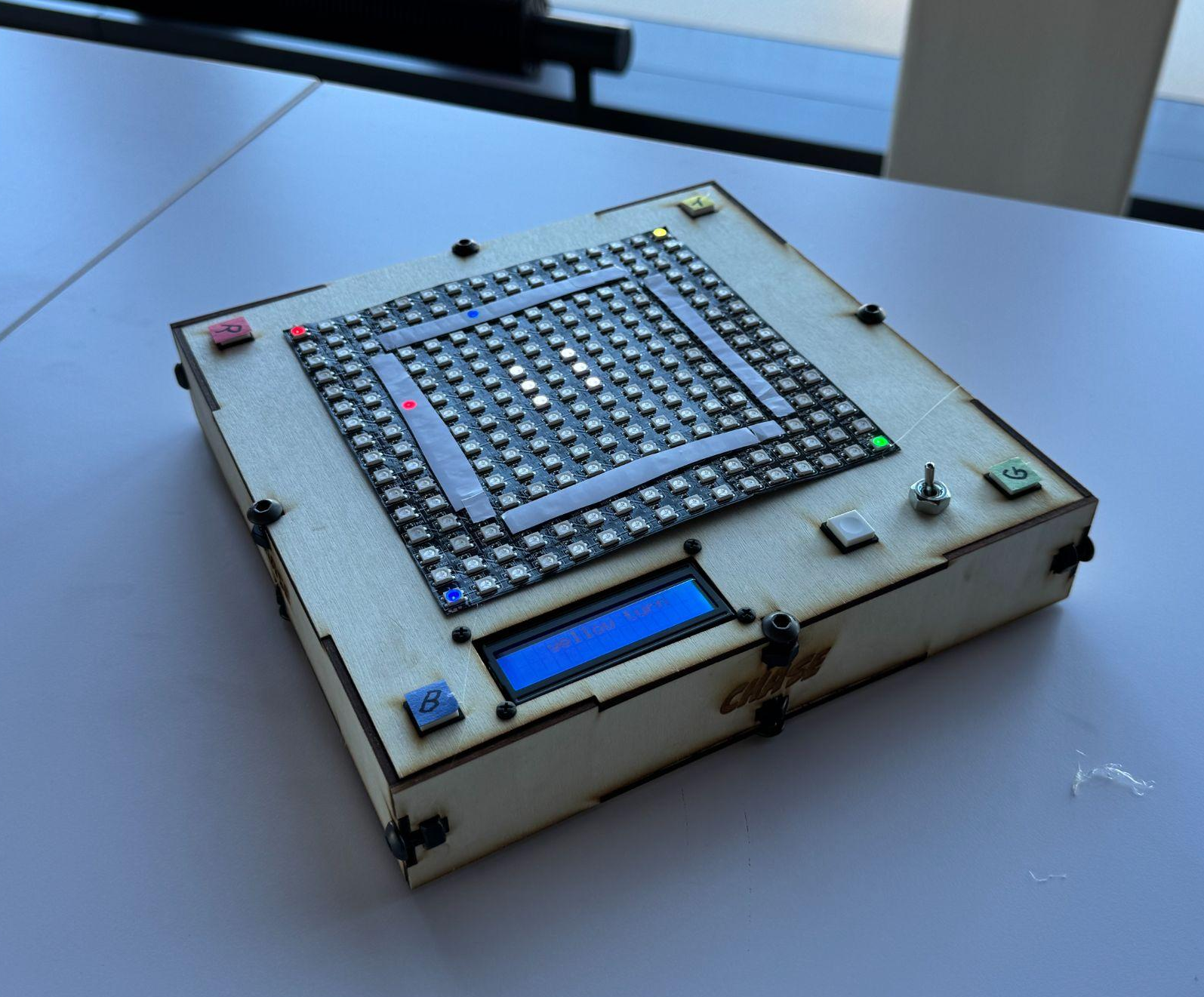
HOW TO PLAY!
CHASE is a reimagined electronic version of the popular board game “Trouble”
Players take turns “rolling” a die and moving their piece around the board
Need a 6 to get on the board
Once a player rolls a number that lets them land exactly in their home base, they win!
If a player over-rolls, they are sent to the spot before their home base
But be careful, if another player lands on you, you get sent all the way back to the beginning
Notes:
Ella

Slide 3
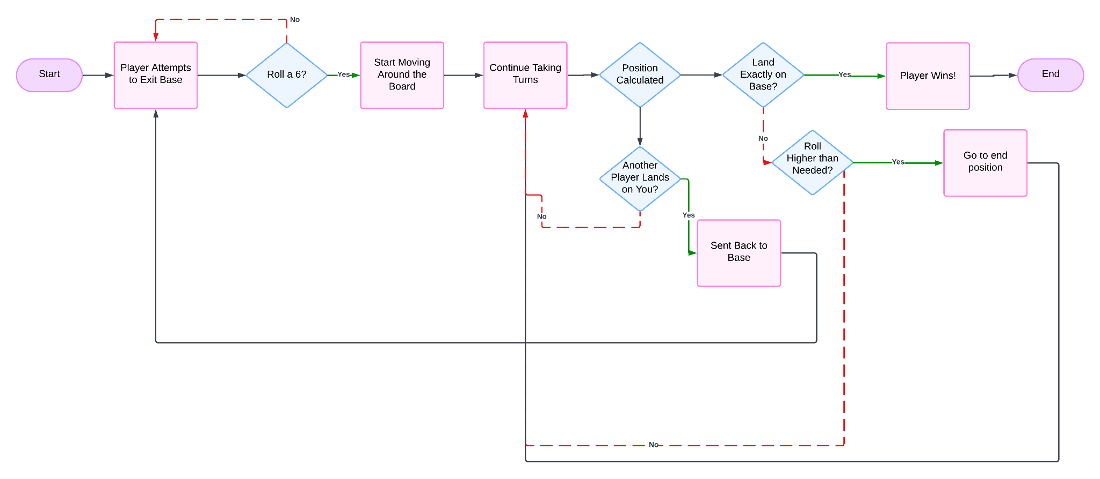
HOW IT WORKS

Slide 4
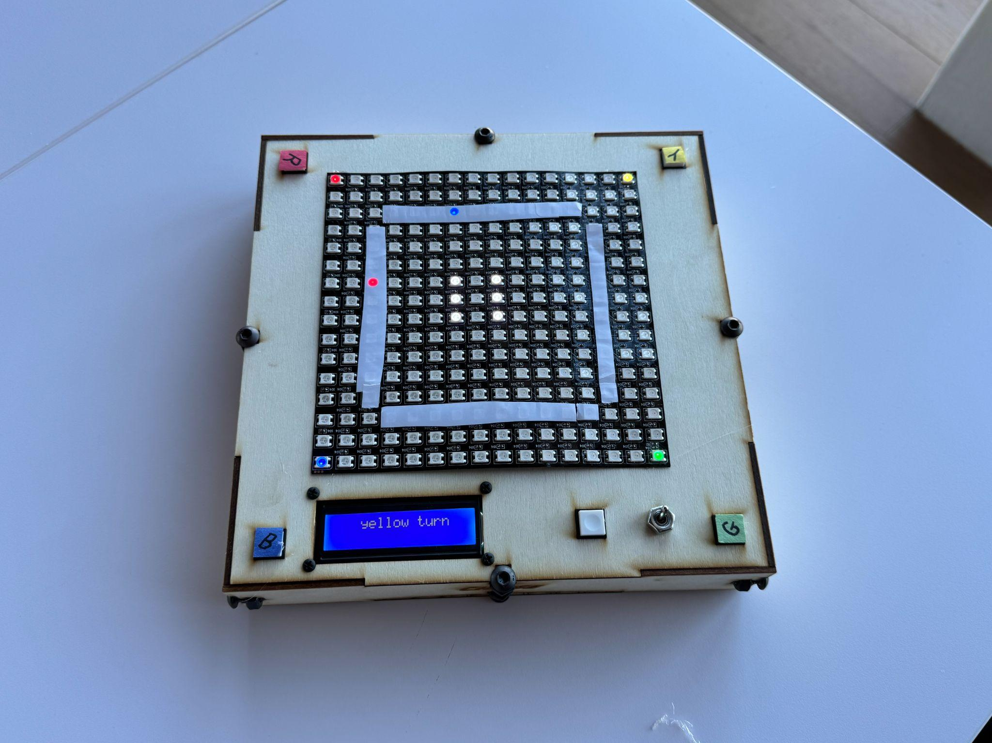
HOW IT WORKS
LCD Information Display
Durable Wooden Carrying Case
5x Momentary PCB Buttons
Neopixels WS2812B 16x16 LED
On/Off Switch
Reset Button
Piezo Buzzer (internal)
Notes:
Callouts:
Neopixels WS2812B 16x16 LED
On/Off Switch
5x Momentary PCB Switches
Durable Wooden Carrying Case
Secondary LCD Information Display

Slide 5
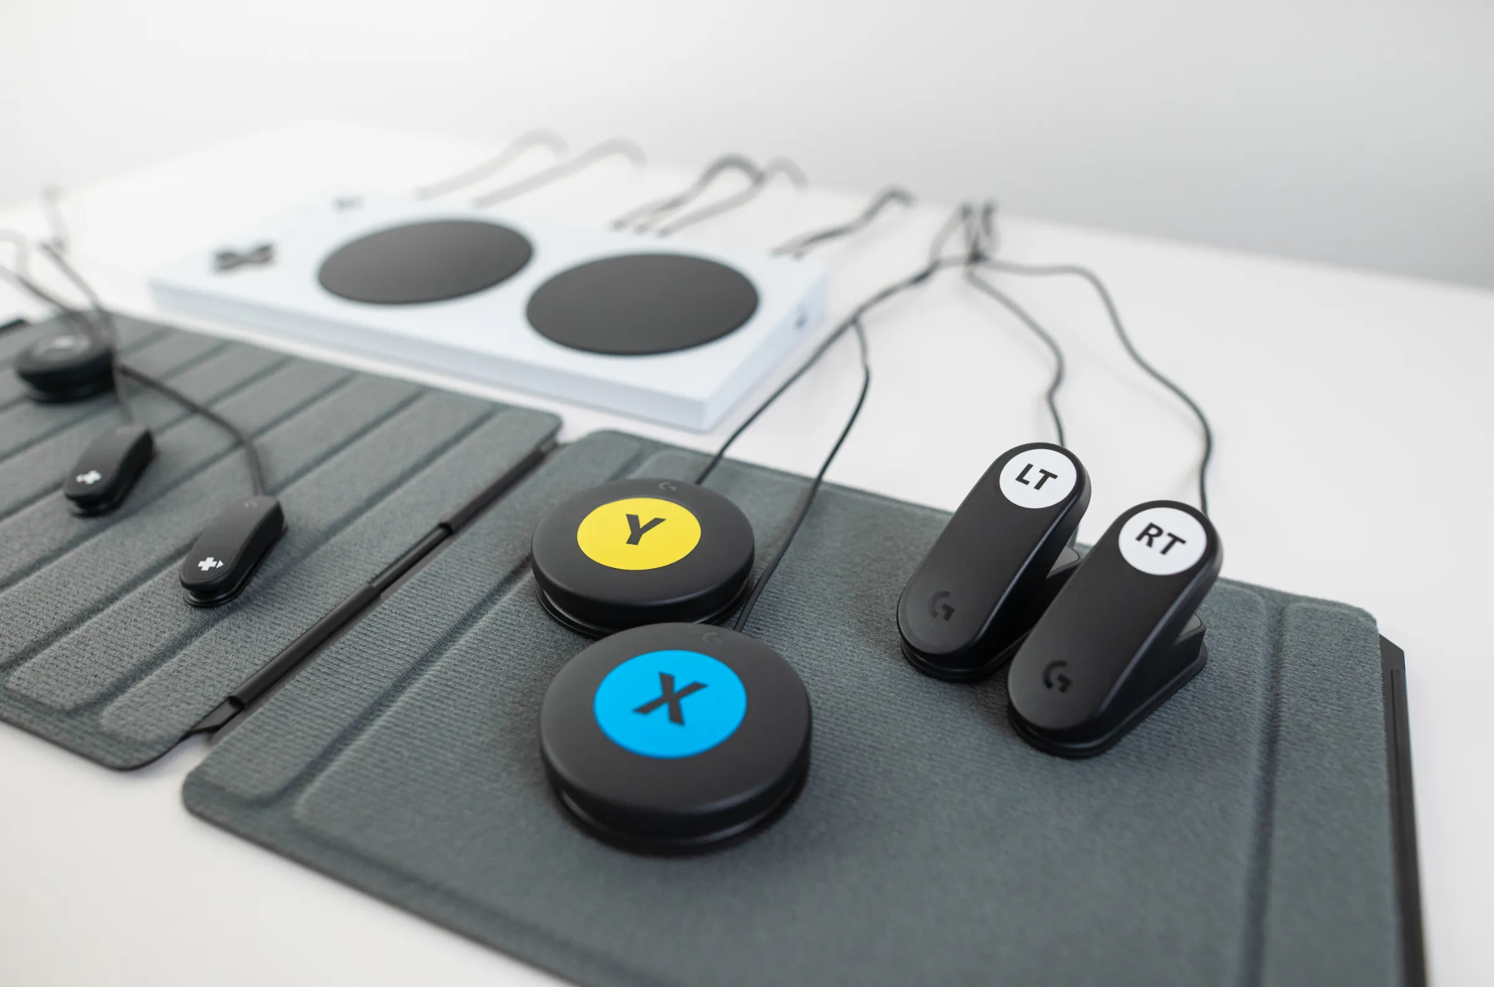
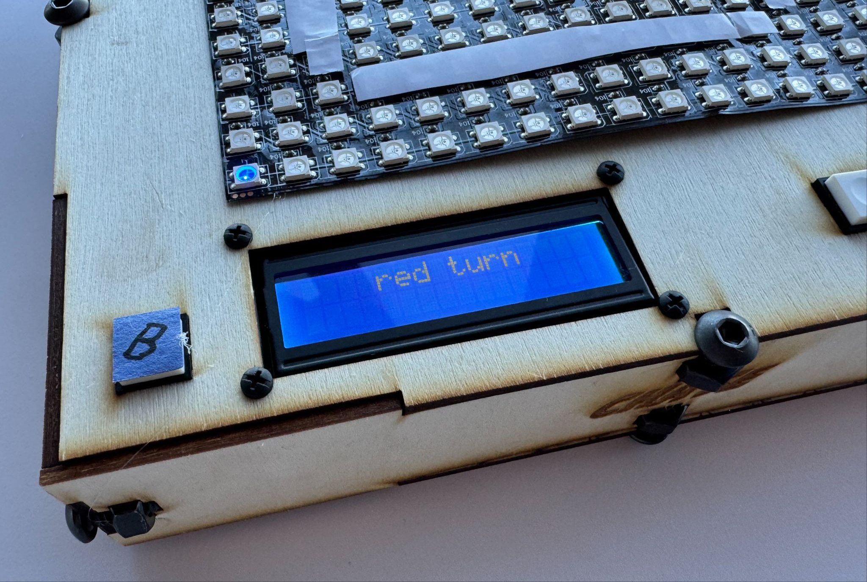
INCLUSIVITY & ANTI-CHEATING
CHASE is a simple electronic board game that anyone, of any age or language ability can learn to play in just a few minutes
Instructions on LCD screen
Player buttons large and tactile
Color coded and labeled
Large LED matrix brightness with adjustable brightness
Blocked from rolling if it’s not your turn

Slide 6
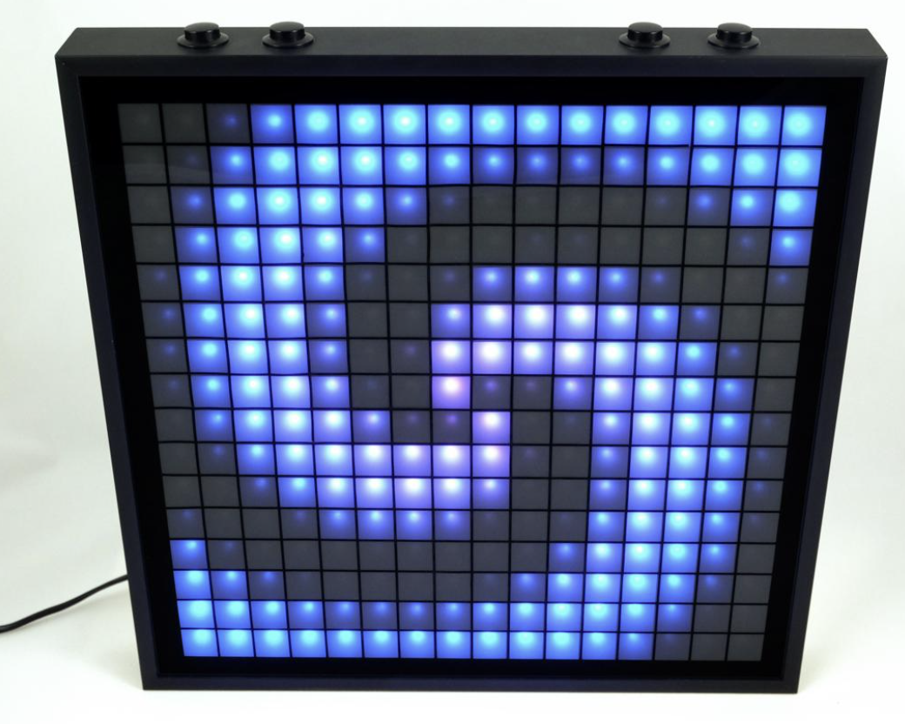
NEXT STEPS
Housing
Hiding LED matrix through blurry screen
Cleaner interface and more marketable
Victory animation on matrix
Music for entirety of game with option to turn music off

Slide 7
DEMO!

Slide 8

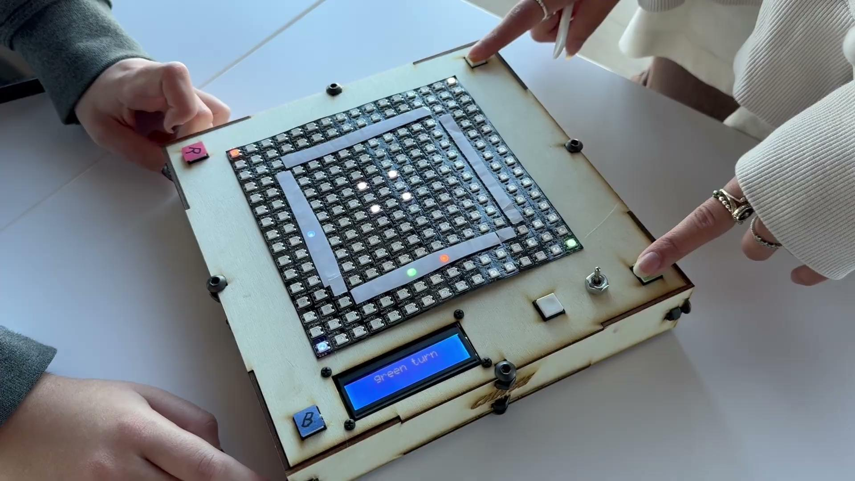
OVERLAP AND WIN
Overlap
Win

Slide 9
TABLE OF CONTENTS
01
02
Theory lesson
Features of the topic
03
04
Tips
Practical exercise
Here you could describe the topic of the section
Here you could describe the topic of the section
Here you could describe the topic of the section
Here you could describe the topic of the section

Slide 10
WHAT IS THIS TOPIC ABOUT?
Mercury
Jupiter
Venus
Mercury is the smallest planet in the Solar System
Jupiter is a gas giant and the biggest planet of them all
Venus is terribly hot, even hotter than Mercury

Slide 11
“This is a quote, words full of wisdom that someone important said and can inspire the reader.”
—Someone Famous

Slide 12
FEATURES OF THIS TOPIC
Mars
Mercury
Jupiter
Neptune
Despite being red, it’s actually a cold place
It’s the closest to the Sun and the smallest
It’s the biggest planet in the Solar System
Neptune is the farthest planet from the Sun

Slide 13
6,328,516
Big numbers catch your audience’s attention

Slide 14
INTRODUCTION
Mercury is the closest planet to the Sun and the smallest one in the Solar System—it’s only a bit larger than the Moon

Slide 15
CONCEPTS
A
B
First concept
Second concept
Jupiter is a gas giant and the biggest planet
Neptune is the farthest planet from the Sun

Slide 16
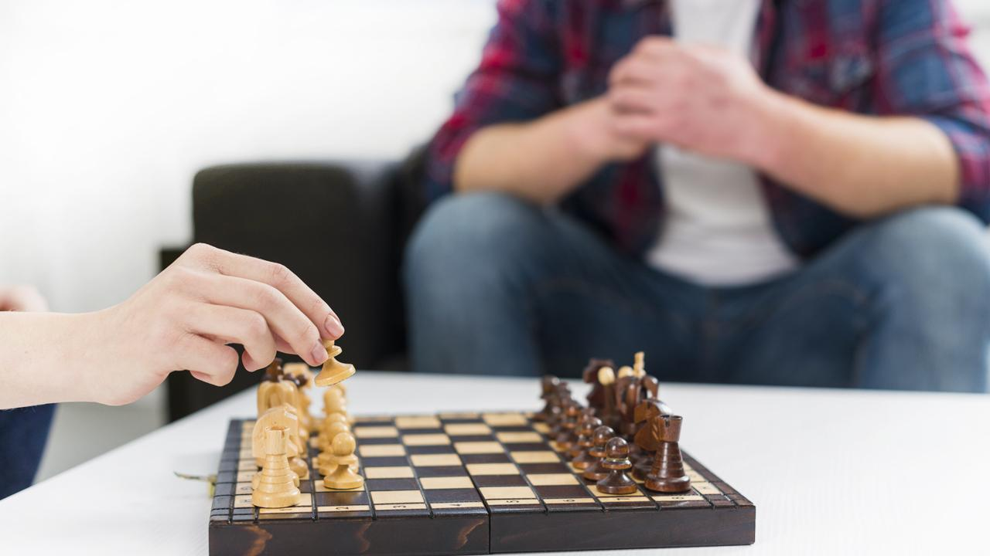
A PICTURE IS WORTH A THOUSAND WORDS

Slide 17
EXAMPLES
Mars
Mercury
Despite being red, it’s actually a cold place
It’s the closest to the Sun and the smallest
Jupiter
Neptune
It’s the biggest planet in the Solar System
Neptune is the farthest planet from the Sun

Slide 18
RECOMMENDATIONS
Mercury
Venus
Mars
Jupiter
Saturn
Neptune
Mercury is the closest planet to the Sun
Venus is the second planet from the Sun
Despite being red, Mars is a cold place
It’s a gas giant and the biggest planet
Saturn is the ringed one and a gas giant
It’s the farthest planet from the Sun

Slide 19
8,483,943,671
5,685,953,333
7,858,124,377
This is a big number to highlight an important data
This is a big number to highlight an important data
This is a big number to highlight an important data

Slide 20
LET’S PLAY A GAME!

Slide 21

A PICTURE ALWAYS REINFORCES THE CONCEPT
Image reveals large amounts of data, so remember, use an image instead of a long text

Slide 22
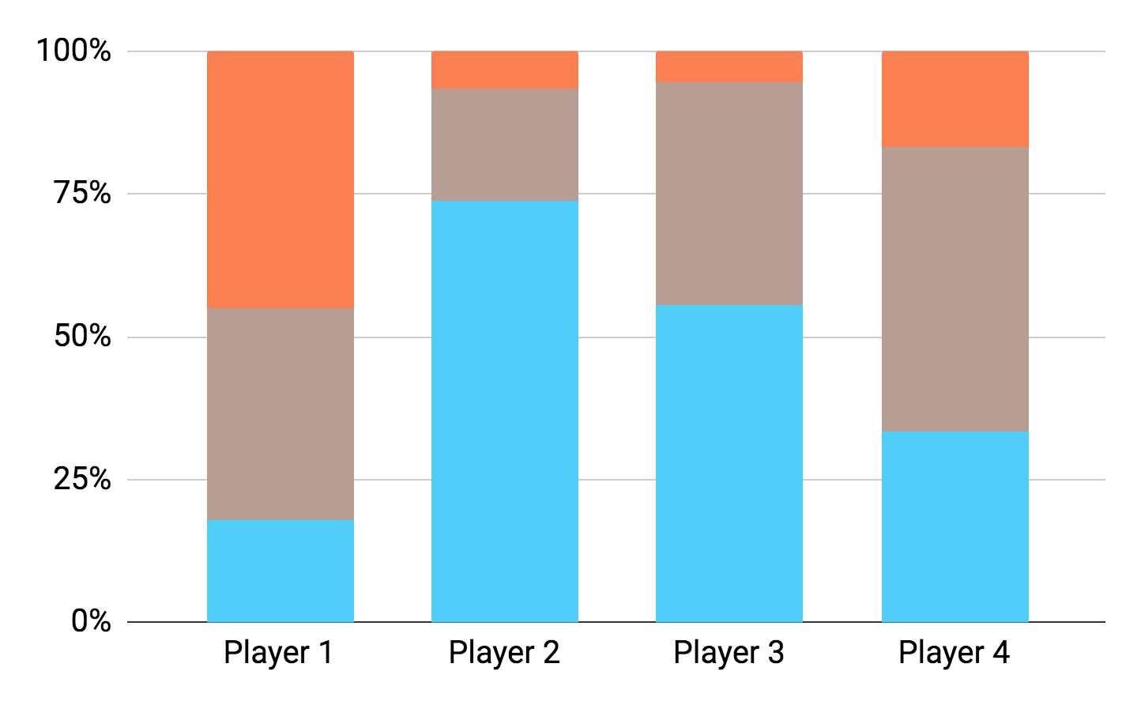
THIS IS A GRAPH
Mercury
Venus
Jupiter
To modify this graph, click on it, follow the link, change the data and paste the new graph here, replacing this one

Slide 23
THIS IS A MAP
Mercury
Mercury is the closest planet to the Sun
Jupiter
Jupiter is a gas giant and the biggest planet
Venus
Venus is the second planet from the Sun

Slide 24
THIS IS A TABLE
 | Mercury | Mars | Jupiter
2020 | 566 | 345 | 179
2021 | 968 | 258 | 977
2022 | 387 | 629 | 498

Slide 25
A TIMELINE ALWAYS WORKS
02
Venus
Venus has a beautiful name
01
03
Jupiter
Saturn
It’s a gas giant and the biggest planet
Saturn is the ringed one and a gas giant

Slide 26
THE SLIDE TITLE GOES HERE
Do you know what helps you make your point clear? Lists like this one:
They’re simple
You can organize your ideas clearly
You’ll never forget to buy milk!
And the most important thing: the audience won’t miss the point

Slide 27
01
NAME OF THE SECTION
You could enter a subtitle here if you need it

Slide 28
CHECKMATE!
Drag and drop each one of the pieces and enjoy your chess game!

Slide 29
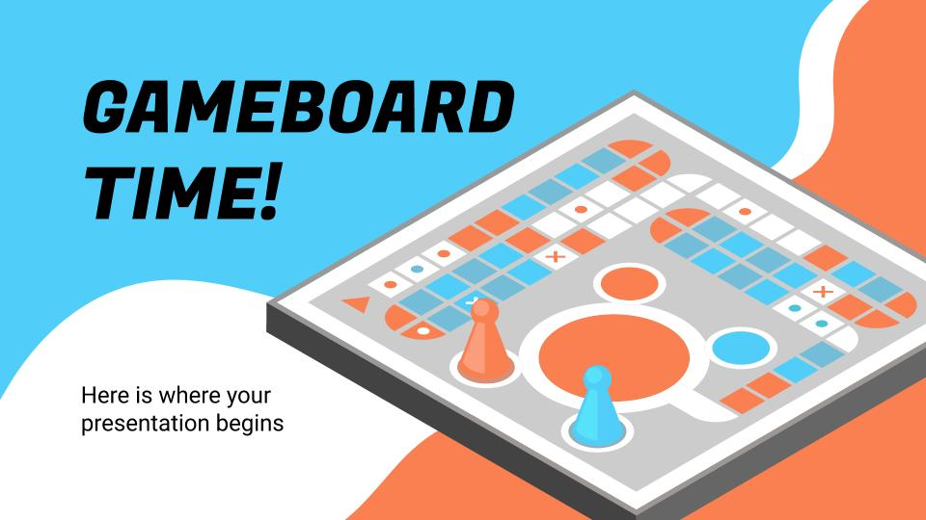
MULTIMEDIA
You can replace the image on the screen with your own work. Just delete this one, add yours and center it properly

Slide 30
THANKS!
Do you have any questions? addyouremail@freepik.com +91 620 421 838 Yourcompany.com
Please keep this slide for attribution.

Slide 31
ALTERNATIVE RESOURCES

Slide 32
ALTERNATIVE RESOURCES
Photos
Young couple playing the board game in the kitchen
Close-up of young woman playing the chess board game
Close-up of a man playing wooden blocks tower game
Excited young woman sitting with her boyfriend cheering after winning the chess game
Photos
Multigenerational men playing chess
Family playing with block wooden game on table in living room
Close-up yahtzee game on white table
Top view home games accessories
Woman winning at yahtzee game
Top view women playing checkers

Slide 33
RESOURCES
Vectors
Friends playing ludo game
Abstract colorful flow shapes background
Abstract wallpaper
Abstract background fluid design
People winning and losing while playing ludo game
Board game collection
High view board games society
People having fun playing ludo game
Set of challenging board games
Table games icon pack
Photos
Close-up of couple playing the wooden chessboard at home
Excited people enjoying card game

